Slide 1


Artificial Intelligence (Machine Learning & Deep Learning)
NAVTTC & Strings Technologies
by Salman Ahmad

Slide 2
Outline Week 6 Day 1&2
Introduction to Natural Language Processing
&
Text Preprocessing

Slide 3
What is NLP?
NLP is the intersection of linguistics and machine learning.
It enables computers to understand, interpret, and generate human language.
Why? Because text data is everywhere: emails, chats, documents, reviews.
Key Goals of NLP:
Understand meaning and structure of language.
Translate, summarize, classify, or answer questions.

Slide 4
Language Components in NLP
Syntax
What: Grammar rules of sentence structure.
Why: Ensures correctness; helps identify sentence boundaries.
Where: Parsing, translation, grammar checking.
Semantics
What: Meaning of words and phrases.
Why: Needed for comprehension.
Where: QA systems, chatbots, sentiment analysis.

Slide 5
Language Components in NLP
Pragmatics
What: Contextual meaning.
Why: Understand intentions beyond literal text.
Where: Sarcasm detection, conversation modeling.
Discourse
What: Coherence across multiple sentences.
Why: Track subjects, pronouns, and topics.
Where: Summarization, coreference resolution.

Slide 6
NLP Curves and Future
Classical NLP: Rule-based systems.
Statistical NLP: Feature-based models (SVM, CRF).
Deep NLP: Embeddings, RNNs, Transformers.
Current Trends: LLMs (like ChatGPT), few-shot learning.
Future Directions
More contextual understanding
Multimodal NLP (text + vision)
Emotion-aware and empathetic AI

Slide 7
Preprocessing for NLP: Why?
Raw text is messy. Machines can't handle ambiguity.
Goal: Clean and structure text to make it processable.

Slide 8
NLP Preprocessing – steps
Noise Removal
What: Remove irrelevant characters (punctuation, HTML tags, emojis).
Why: Reduces clutter and irrelevant information.
Where: Any NLP task (preprocessing step).
Stopword Removal
What: Remove common words (e.g., "the", "is").
Why: These add little semantic value.
Where: Bag-of-Words, TF-IDF models.

Slide 9
NLP Preprocessing – steps
3. Tokenization
What: Split text into words or sentences.
Why: Fundamental for any NLP operation.
Where: Everywhere — classification, parsing, NER.
4. Word Segmentation
What: Identify word boundaries in unspaced languages.
Why: Required for languages like Chinese or Thai.
Where: Asian NLP, cross-lingual applications.

Slide 10
NLP Preprocessing – steps
5. Stemming
What: Reduce words to base/root form (e.g., "running" -> "run").
Why: Treat similar words the same.
Where: Search, classification, topic modeling.
6. Lemmatization
What: Reduce to base form using linguistic rules.
Why: More accurate than stemming.
Where: Search engines, chatbots, QA systems.

Slide 11
NLP Preprocessing – steps
7. Normalization
What: Convert text to a standard format (lowercase, spelling).
Why: Reduces sparsity.
Where: Text classification, clustering.

Slide 12
POS (Part of Speech) Tagging
Assigns grammatical category to each word: noun, verb, adjective, etc.
Enables syntactic parsing, chunking, and understanding of sentence structure.
Useful for downstream tasks like named entity recognition, sentiment analysis.
Implemented via models like HMMs, CRFs, or deep learning-based taggers.
Modern tools: spaCy (fast and accurate), NLTK (educational), Stanza (multi-language).

Slide 13
Named Entity Recognition (NER)
Extracts named entities from text: people, locations, organizations, dates.
Common annotation formats: BIO, BIOES tagging.
Trained using labeled datasets like CoNLL-2003, OntoNotes.
Crucial for information extraction, question answering, knowledge graph building.
Pretrained models are available in spaCy, HuggingFace Transformers, Flair.

Slide 14
Chunking and Chinking
Chunking: Groups tagged words into syntactic units (noun phrases, verb phrases).
Chinking: Removes specific elements from previously formed chunks.
Common in shallow parsing and identifying phrase structures.
Regex-based chunking can be used in NLTK.
Example: Chunk "The quick brown fox" as one noun phrase (NP).

Slide 15
WordNet
A lexical database organized by synonym sets (synsets).
Includes relations: synonyms, antonyms, hyponyms, hypernyms.
Enables semantic similarity scoring and word sense disambiguation.
Used in tools like Lesk algorithm and semantic search systems.
Integrated with NLTK for exploration and use in NLP applications.

Slide 16
Text as Features — Bag-of-Words (BoW)
Converts text into fixed-length vector of word frequencies.
Discards grammar, word order, and context.
High dimensional and sparse.
Still useful for basic classification, spam detection, clustering.
Can be enhanced with n-grams to retain some local word order.

Slide 17
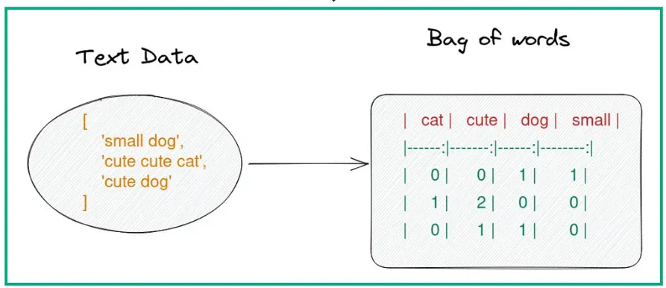
Text as Features — Bag-of-Words (BoW)

Slide 18
Text as Features — TF-IDF
Term Frequency–Inverse Document Frequency gives importance to rare words.
Reduces the impact of common terms in the corpus.
Better than BoW when documents vary in length.
Commonly used in document classification, retrieval, topic modeling.
Implemented via TfidfVectorizer in scikit-learn.

Slide 19
Feature Selection & Extraction
Selects the most informative features to improve model performance.
Reduces overfitting and speeds up training.
Methods include:
Chi-square test: identifies features most associated with target.
Mutual information: measures dependency between feature and label.
PCA/TruncatedSVD: dimensionality reduction techniques.
Used before training ML models or embedding inputs.

Slide 20
Document Similarity
Measures how similar two documents are in meaning or structure.
Techniques include:
Cosine similarity (most common for BoW/TF-IDF vectors).
Jaccard similarity (based on set overlap).
Euclidean distance (for short, normalized vectors).
Embedding-based similarity using Word2Vec, GloVe, BERT.
Applications: document clustering, duplicate detection, recommendations.

Slide 21
Libraries for NLP – NLTK
Educational and modular.
Provides tools for:
Tokenization
POS tagging
Stemming and Lemmatization
Chunking and parsing
WordNet access
Good for learning and prototyping.

Slide 22
Libraries for NLP – NLTK
Industrial-strength NLP library.
Key features:
Pretrained NER, POS, and dependency parsers
Fast vectorization and tokenization
Integration with deep learning pipelines
Support for multiple languages and domain adaptation
Excellent choice for production NLP systems.

Slide 23
Sentiment Analysis of Movie Reviews
Dataset
IMDB Movie Reviews Dataset
50,000 reviews labeled as positive or negative
Available via tensorflow_datasets or Kaggle
Preprocessing Steps
Text Cleaning: Lowercasing, punctuation removal
Tokenization: Word-level using nltk or spaCy
Stopword Removal: Remove common words that add noise
Vectorization:
For ML model: Use TF-IDF
For DL model: Use word embeddings (e.g., Word2Vec, GloVe)

Slide 24
Sentiment Analysis of Movie Reviews
ML Model: Logistic Regression with TF-IDF
Convert preprocessed text into TF-IDF features
Train a logistic regression classifier
Evaluate using accuracy, precision, recall, F1-score
Deep Learning Model: LSTM with Embeddings
Tokenize and pad sequences
Use Embedding + LSTM layers in Keras
Train and validate the model on IMDB data

Slide 25
Sentiment Analysis of Movie Reviews
Comparison of Models
Logistic Regression
LSTM Model
Metrics
Accuracy
Speed
Performance on Long Sequences

Slide 26

Questions?
"He who asks a question is a fool for a minute; he who does not remains a fool forever." – Confucius

